Slide 1

Li-Fi: Light
Speed Rescue
SRI SAIRAM INSTITUTE OF TECHNOLOGY
Li-Fi Alternative for Wi-Fi

Slide 2
Table of Contents
01
02
03
04
Introduction
What is Li-Fi?
How does Li-Fi work ?
Motivation & Theories
Why we chose this technology and what initiated our project?
Our Idea & Applications
How are we going to apply the technology in our problem statement?
References
Sites which helped us.

Slide 3


INTRODUCTION
What is Li-Fi?
Li-Fi, also referred to as "Light Fidelity” is a wireless optical networking technology. It harnesses the power of LEDs to facilitate the transmission of data.In 2011, Professor Harald Haas showcased a groundbreaking Li-Fi demonstration during his TED Global Talk on Visible Light Communication (VLC).

Slide 4
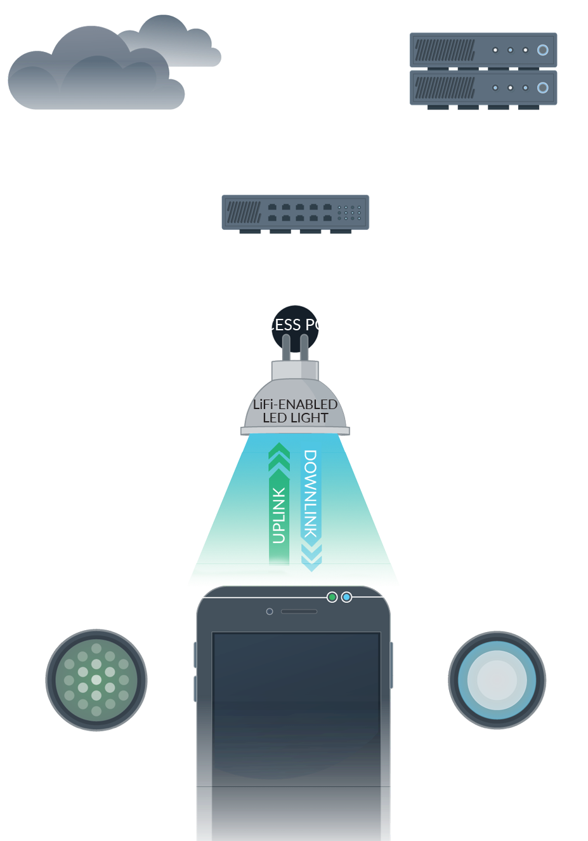
How does Li-Fi works?
When an electrical current is applied to a LED light bulb a stream of light (photons) is emitted from the bulb. LED bulbs are semiconductor devices. This means that the signal can be sent by modulating the light at different rates. The signal can then be received by a detector that interprets the changes in light intensity (the signal) as data. Also when the LED is ON, you transmit a digital 1 and when it is OFF you transmit a 0.

Slide 5
PROBLEM STATEMENT: During natural calamities, such as earthquakes, hurricanes, or floods, the primary casualty often includes traditional communication infrastructure. These disasters can disrupt not only cellular networks but also Wi-Fi connections, severely limiting communication capabilities.
MOTIVATION
During the recent devastating floods in Tamil Nadu, countless individuals found themselves struggling with the flood consequences.
Amidst the chaos, the delayed arrival of triage escalated the already worse situation, leaving many without immediate medical assistance and adding to the sense of desperation.
This situation motivated us to establish improved communication channels between the survivors and the frontline responders, facilitating more efficient coordination and aid delivery.

Slide 6
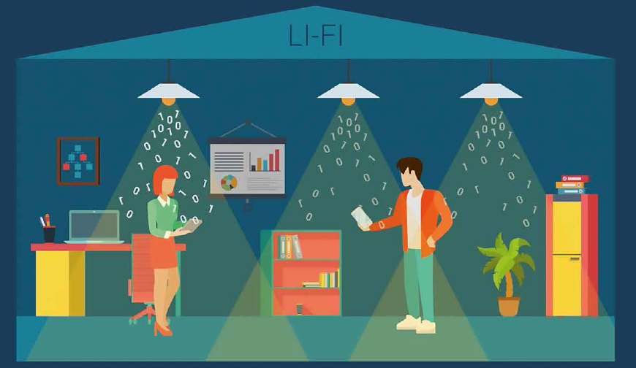
Our Views & Application

Slide 7

Li-Fi enabled streetlights replacing traditional Wi-Fi towers which are strategically reconstructed with solar panels and secondary batteries.
This transformation converts ordinary streetlights into self-sustaining Li-Fi access points, capable of operating independently of external power sources.
The utilization of solar panels ensures uninterrupted functionality, even in the absence of electricity, thereby establishing an emergency network grid.

Slide 8

The utilization of solar panels ensures uninterrupted functionality, even in the absence of electricity, thereby establishing an emergency network grid. This grid serves as a vital platform for critical information dissemination and communication during disasters, significantly aiding first responders in their triage and rescue efforts. The technology enables rapid transmission of emergency data to essential facilities such as health centers and firehouses, facilitating swift response and coordination.

Slide 9
By bridging the communication gap during crises, this LED Li-Fi system not only enhances emergency alertness but also contributes to long-term development in rural communities by fostering connectivity and resilience.

Slide 10
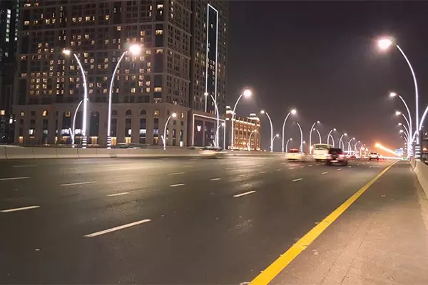
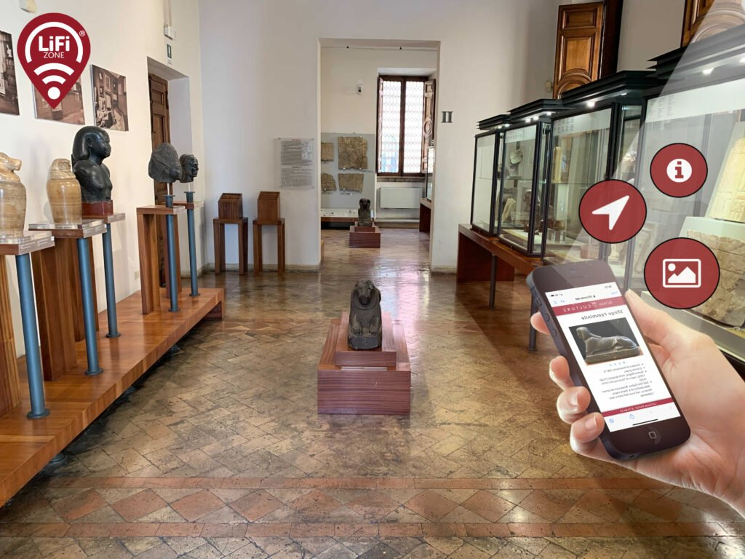
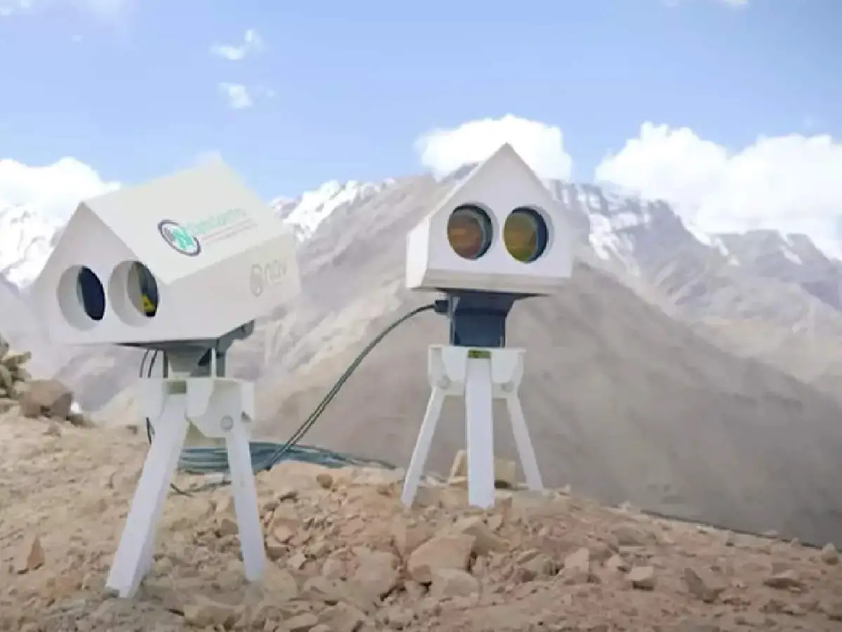
APPLICATONS
DUBAI
LADAKH
ITALY
TN
?

Slide 11
https://www.lifitn.com/blog/2021/2/13/top-30-li-fi-applications-updated-list-including-potential-applications
https://www.purelifi.com/
REFERENCES
https://lifi.co/

Slide 12
THANK YOU!!
QUESTIONS?
TEAM MEMBERS:
HARSHITHA V
VARSHNEE N

